Slide 1
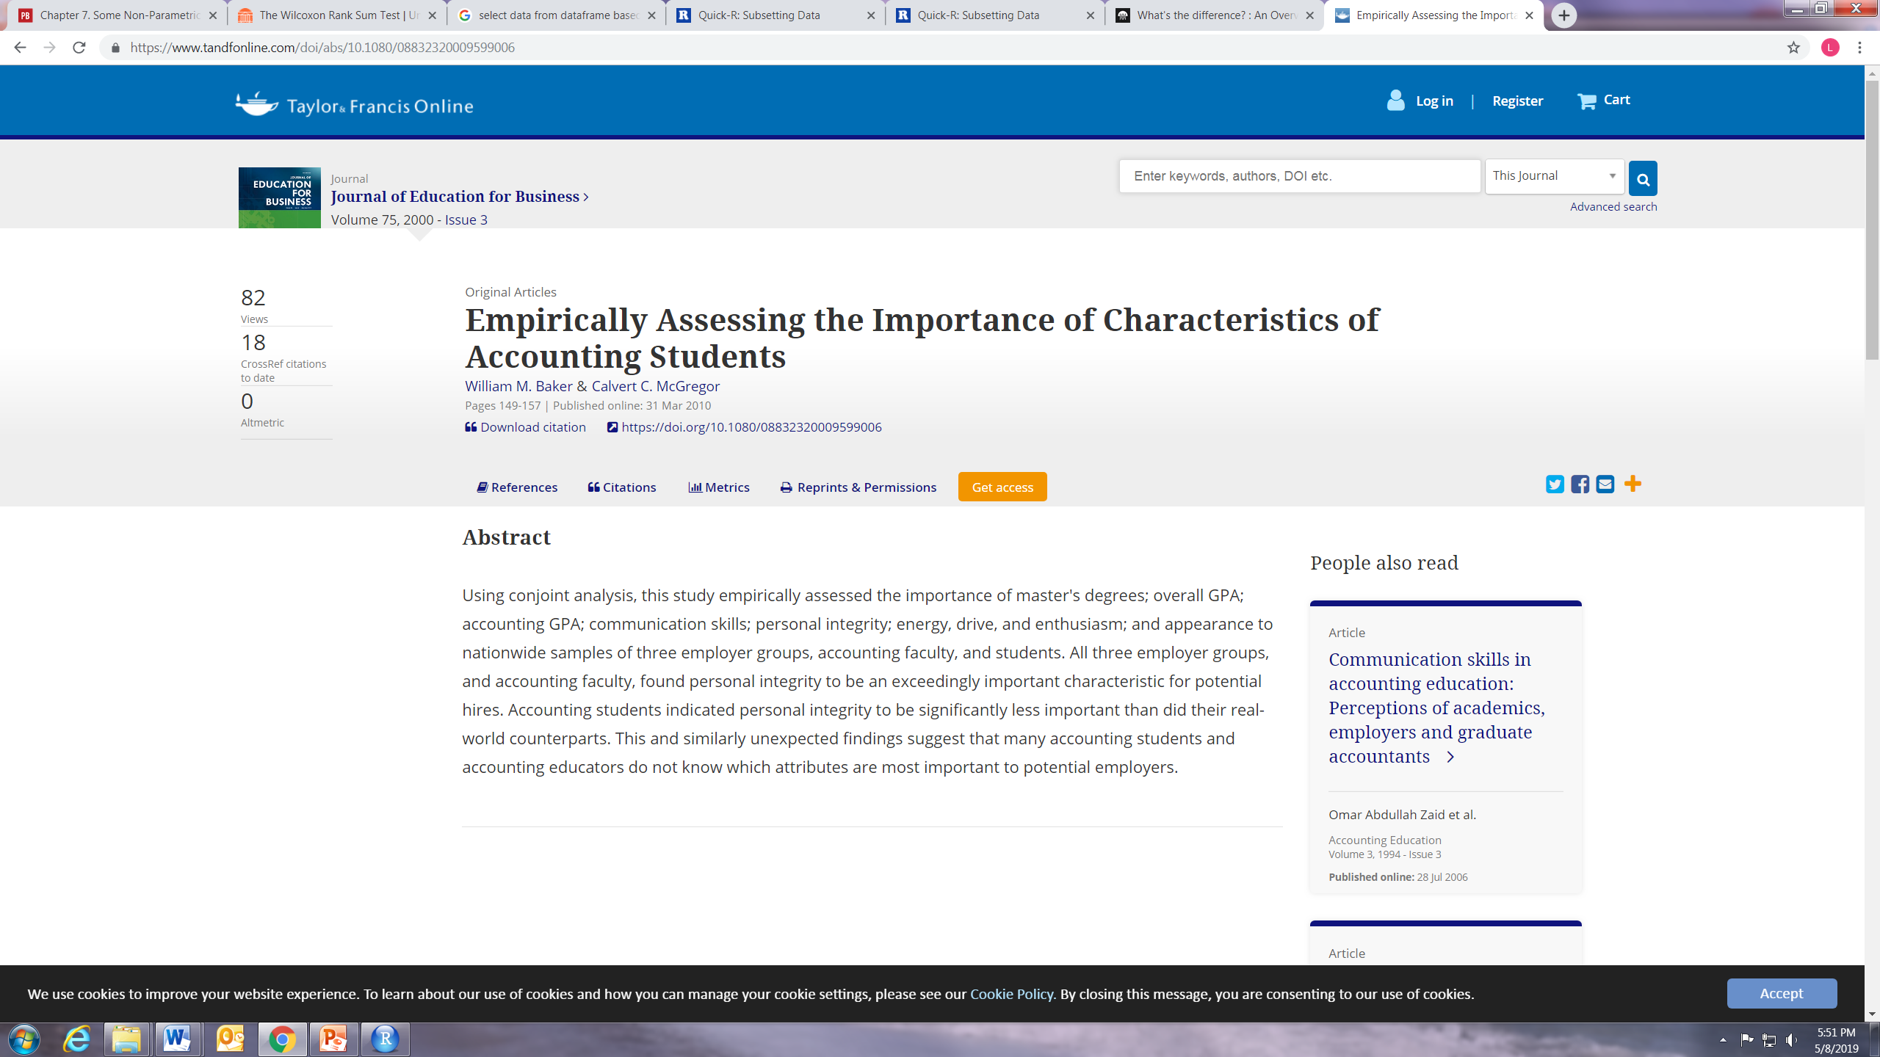
Let’s practice
A study by Baker and McGregor [Empirically assessing the utility of accounting student characteristics, unpublished, 1993] in which both accounting firm partners and students were asked to score the importance of student characteristics in the hiring process. A summary of their findings is in Table below
Data on Importance of Student Attributes
Attribute | Mean: Student Rating | Mean: Big Firm Rating
High Accounting GPA | 2.06 | 2.56
High Overall GPA | .08 | -.08
Communication Skills | 4.15 | 4.25
Personal Integrity | 4.27 | 7.5
Energy, drive, enthusiasm | 4.82 | 3.15
Appearance | 2.68 | 2.31
Data source: Baker and McGregor
Question : If the two groups think the same things are important

Slide 2
Practice example
H_{o}: There is no true difference between what students and Big 6 partners think is important.
H_{a}: There is a difference.
Let’s agree to use a level of significance of .05. We should use a two-tail test because we want to see if the scores are different, not if the Big 6 partners value these things more highly.
What kind of test we should employ and why?
Non-parametric, paired

Slide 3
Solution
The Worksheet for the Wilcoxon Signed Ranks Test
Attribute | Mean Student Rating | Mean Big Firm Rating | Difference | Rank
High Accounting GPA | 2.06 | 2.56 | -.5 | -4
High Overall GPA | .08 | -.08 | .16 | 2
Communication Skills | 4.15 | 4.25 | -.1 | -1
Personal Integrity | 4.27 | 7.5 | -2.75 | -6
Energy, drive, enthusiasm | 4.82 | 3.15 | 1.67 | 5
Appearance | 2.68 | 2.31 | .37 | 3
 | sum of positive ranks = 2+5+3=10
 | sum of negative ranks = 4+1+6=11
 | number of pairs=6

Slide 4
Solution (cont)
Sample statistic, T, is the smaller of the two sums of ranks, so T=10. Decision rule to accept H_{a} if T < 2 (from table), data support H_{o} that there is no difference in what students and Big 6 firms think is important to look for when hiring students. This makes sense, because the attributes that students score as more important, those with positive differences, and those that the Big 6 score as more important, those with negative differences, are mixed together when the absolute values of the differences are ranked. Notice that using the rankings of the differences rather than the size of the differences reduces the importance of the large difference between the importance students and Big 6 partners place on personal integrity. This is one of the costs of using non-parametric statistics.

Slide 5
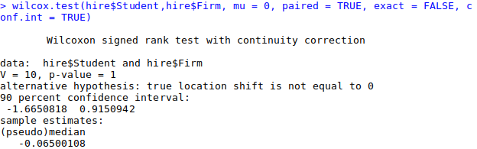
Solution

Slide 6
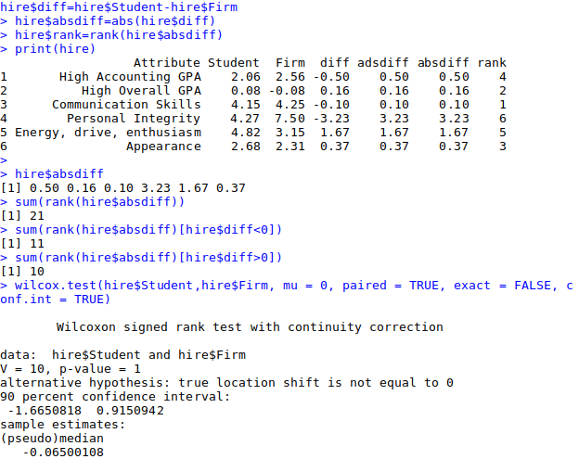
Solution in R

